Slide 1

OMGT1039
Operations Management
Week 5
Quality Control

Slide 2
COMMONWEALTH OF AUSTRALIA
Copyright Regulations 1969
WARNING
This material has been reproduced and communicated
to you by or on behalf of Royal Melbourne Institute
of Technology, (RMIT University) pursuant to Part
VB of the Copyright Act 1968 (the Act).
The material in this communication may be subject to
copyright under the Act. Any further reproduction or
communication of this material by you may be the
subject of copyright protection under the Act.
Do not remove this notice.
First page of scanned document
This presentation includes selected slides from
William J Stevenson (2015) Operations Management, 12 ed. ISBN 10: 1259580091, McGraw Hill

Slide 3
Learning Objectives
List and briefly explain the elements of the control process
Explain how control charts are used to monitor a process, and the concepts that underlie their use
Use and interpret control charts
Explain about Run tests
Use Process Capability

Slide 4
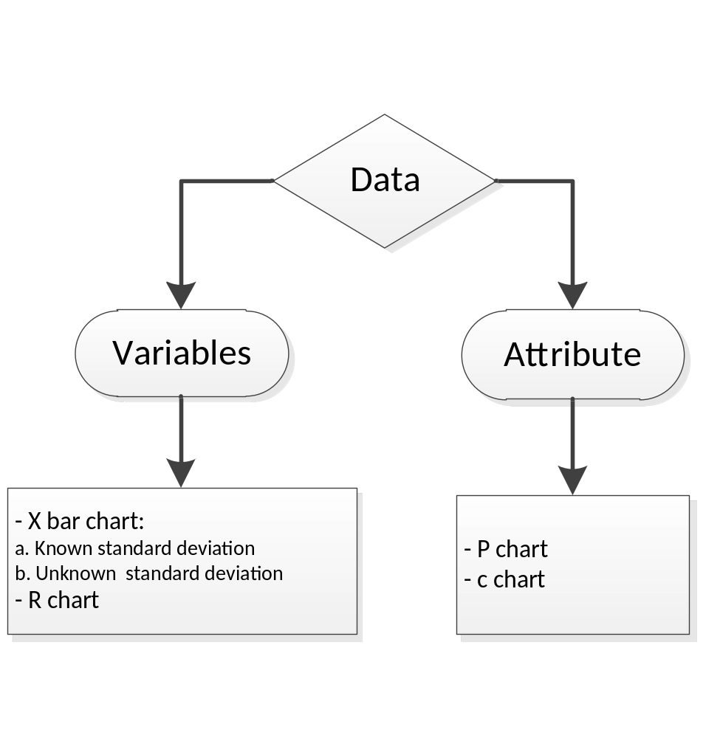
Control Charts for Data Types

Slide 5
Control Charts for Variables
Variables generate data that are measured
  Mean control charts
    Used to monitor the central tendency of a process.
      “x- bar” charts
  Range control charts
    Used to monitor the process dispersion
      R charts

Slide 6
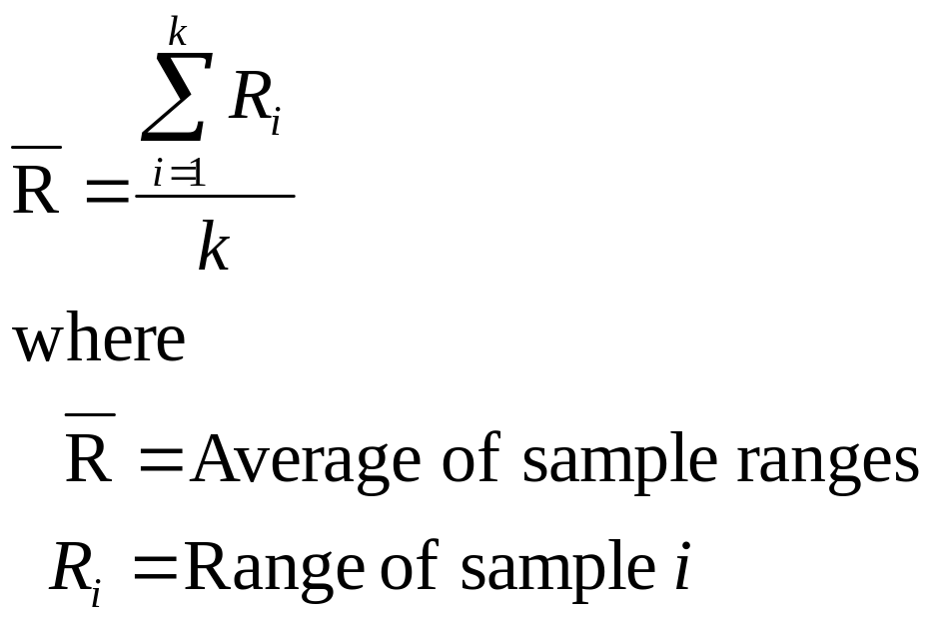
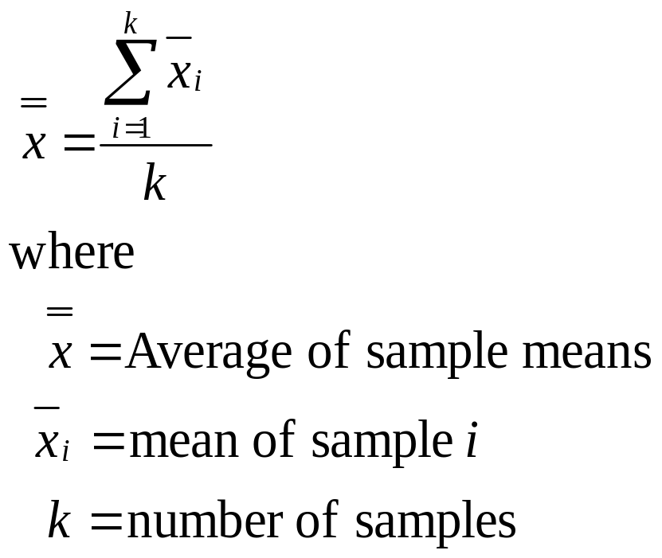
Establishing Control Limits (known standard deviation)

Slide 7
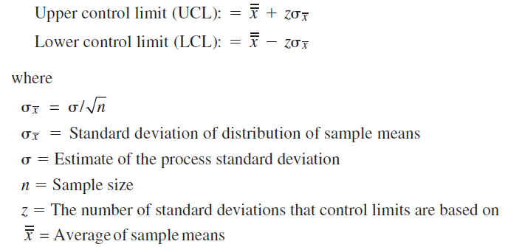
Establishing Control Limits (known standard deviation)
x bar chart

Slide 8
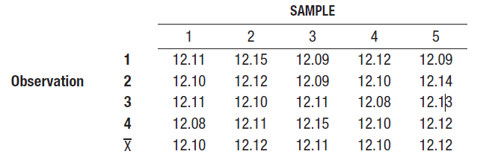
X bar chart Example 1 (see Canvas for data file)
A quality inspector took five samples, each with four observations ( n = 4), of the length of time for glue to dry. The analyst computed the mean of each sample and then computed the grand mean. All values are in minutes. Use this information to obtain three-sigma (i.e., z = 3) control limits for means of future times. It is known from previous experience that the standard deviation of the process is 0.02 minute.
a. Use this information to obtain three-sigma (i.e., z = 3) control limits for means of future times.
b. Is the process (time for glue to dry) normal? Why?
c. For what percent of the products (glue) it takes more than 12.11 minutes dry? More than 12.123 minutes to dry? Between 12.09 to 12.12 minutes to dry? (part c of this question aims to show how to use normal distribution)

Slide 9

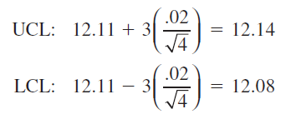
X bar chart Example 1: Solution to part a
Step 1: calculate the mean of the mean
Step 2: Calculate upper and lower limit
n = number of samples or
the size of the sample?
n is the size of the sample

Slide 10
Solution to part b
Process is in control. Why?

Slide 11
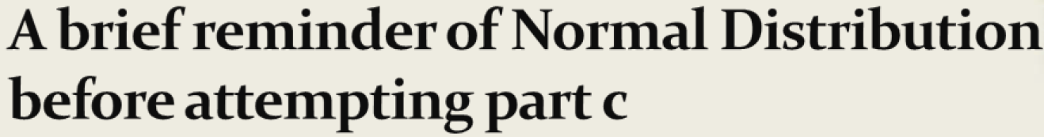
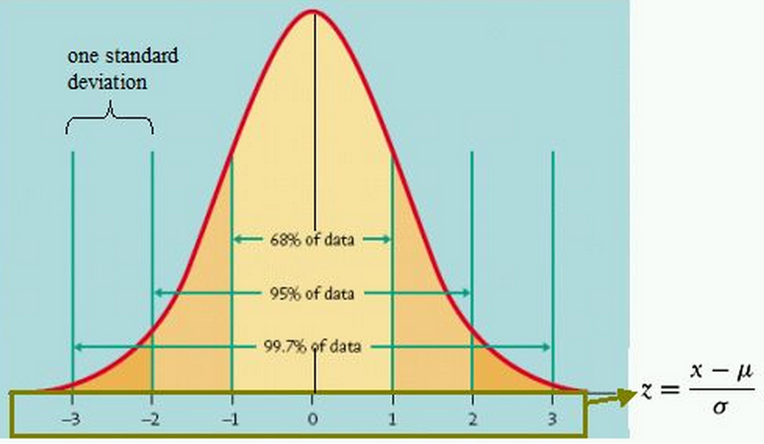
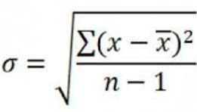

Slide 12

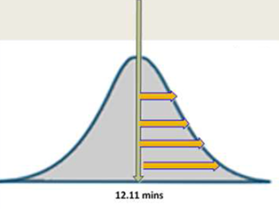
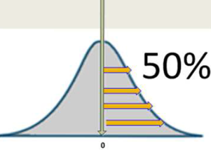




Slide 13

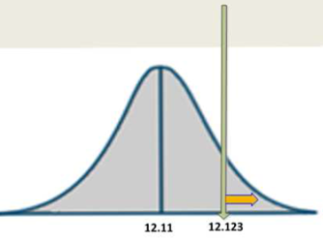
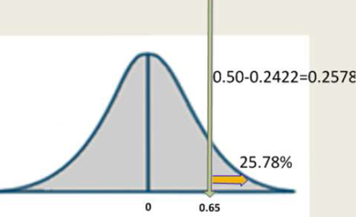


Slide 14

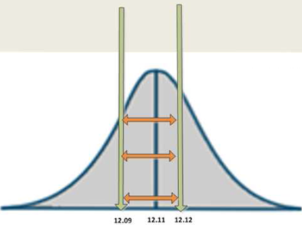
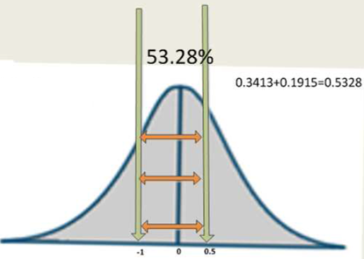


Slide 15
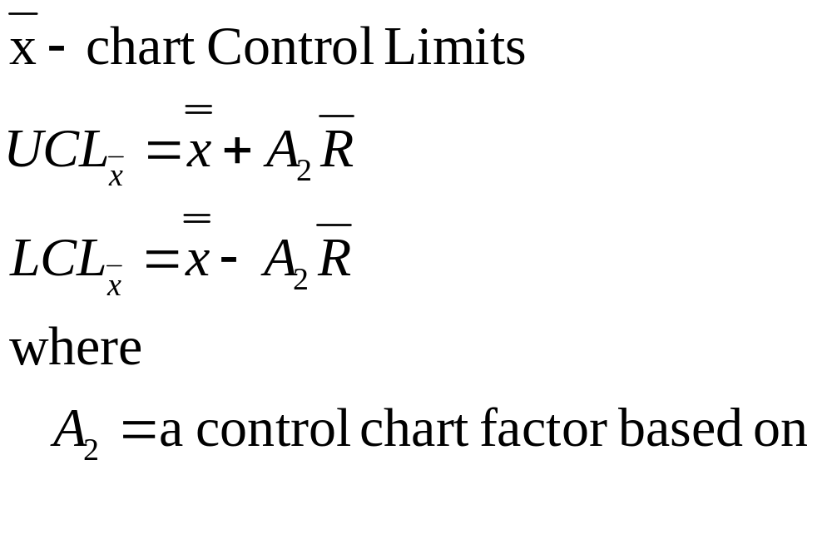
X-Bar Chart: Control Limits (unknown standard deviation)
Used to monitor the central tendency of a process
sample size n: see next slide

Slide 16
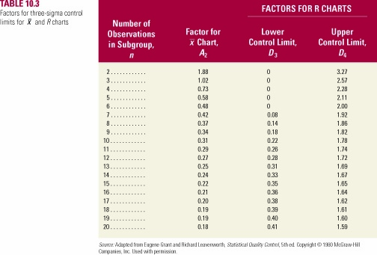
Factors for Three Sigma Control Charts

Slide 17
X bar chart Example 2(unknown SD)
Consider Example 1. The company collected new data shown in the following table (see example 2.xlsx file on Bb for the data). Suppose the standard deviation is unknown. Construct the x bar chart. Use this information to obtain three-sigma (i.e., z = 3) control limits for means of future times.
Solution:
Step 1: Calculate x bar and R bar
X bar = (11.88+11.9+11.77+12.03+12.07)/5 = 11.93
R bar = (0.6+ 0.87+ 1.09+0.25+0.13)/5= 0.59
 |  | Samples
Observations |  | 1 | 2 | 3 | 4 | 5
 | 1 | 11.5 | 11.25 | 12.2 | 11.85 | 12
 | 2 | 12.1 | 12.12 | 11.65 | 12.1 | 12.01
 | 3 | 11.85 | 12.1 | 12.11 | 12.08 | 12.13
 | 4 | 12.08 | 12.11 | 11.11 | 12.1 | 12.12
 |  | Samples
Observations |  | 1 | 2 | 3 | 4 | 5
 | 1 | 11.5 | 11.25 | 12.2 | 11.85 | 12
 | 2 | 12.1 | 12.12 | 11.65 | 12.1 | 12.01
 | 3 | 11.85 | 12.1 | 12.11 | 12.08 | 12.13
 | 4 | 12.08 | 12.11 | 11.11 | 12.1 | 12.12
 | R values | 0.6 | 0.87 | 1.09 | 0.25 | 0.13
 | x bar | 11.88 | 11.9 | 11.77 | 12.03 | 12.07
R= max - min

Slide 18
Step 2: UCL and LCL
    UCL = 11.93 + .73 (.59) = 12.36
    LCL = 11.93 - .73 (.59) = 11.50
Process is in control

Slide 19
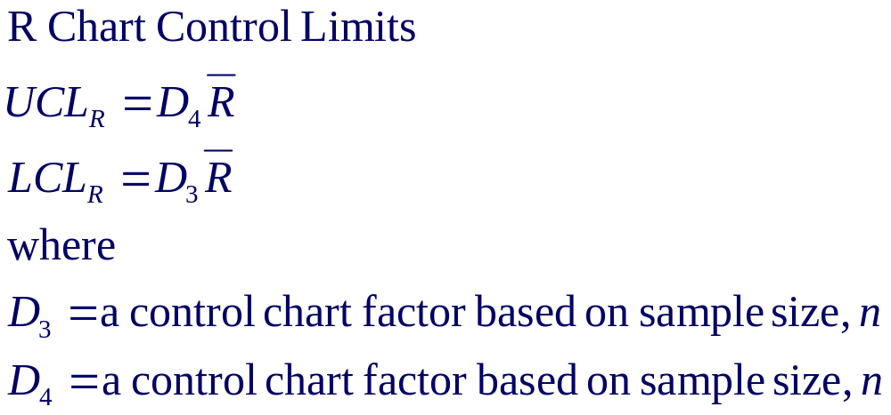
Range Chart: Control Limits
Used to monitor process dispersion

Slide 20
Range Chart: Control Limits: Example 3
Consider the information in Example 2. Setup R chart
Solution:
UCL = 2.28(0.59) =1.35
LCL = 0(0.59) = 0
Process is under control

Slide 21
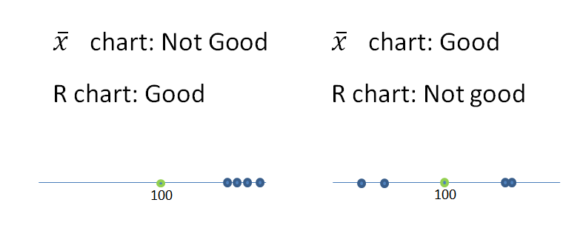

Summary of X bar and R chart

Slide 22
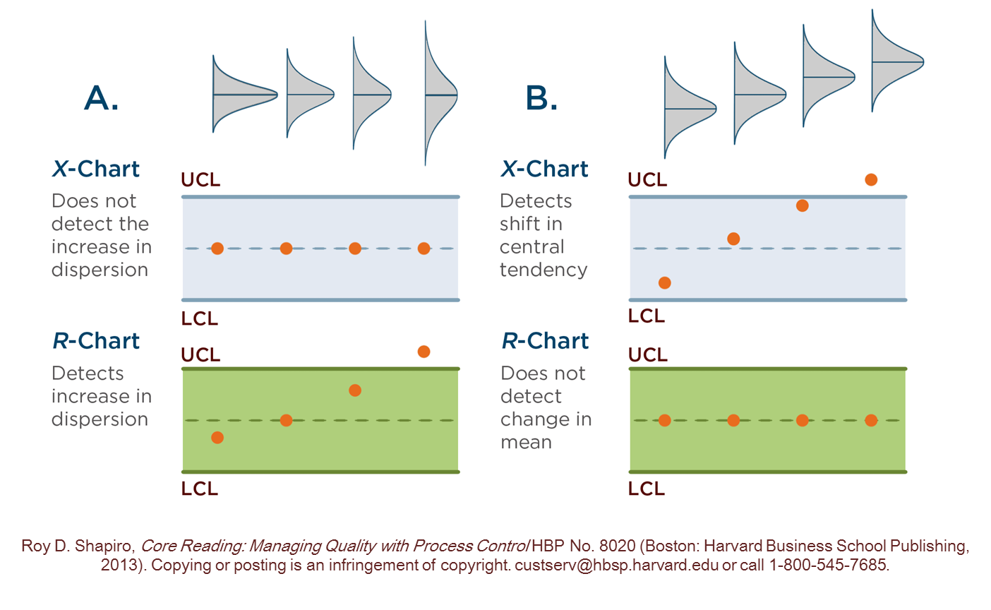
Summary of X bar and R chart

Slide 23
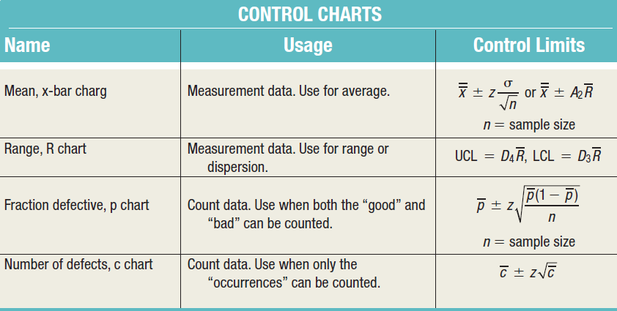
Summary of Control Charts

Slide 24
Run Tests
Even if a process appears to be in control, the data may still not reflect a random process
Analysts often supplement control charts with a run test
  Run test
    A test for patterns in a sequence
  Run
    Sequence of observations with a certain characteristic

Slide 25
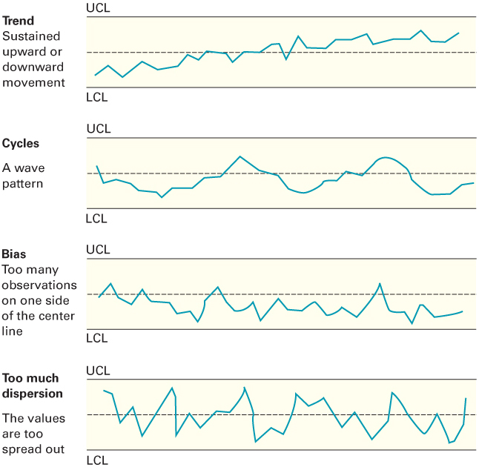
Nonrandom Patterns

Slide 26
Run Tests
Run tests are used to check for non-randomness in process output.
  Run
    Sequence of observations with a certain characteristic
    AAAB ABAA

Slide 27
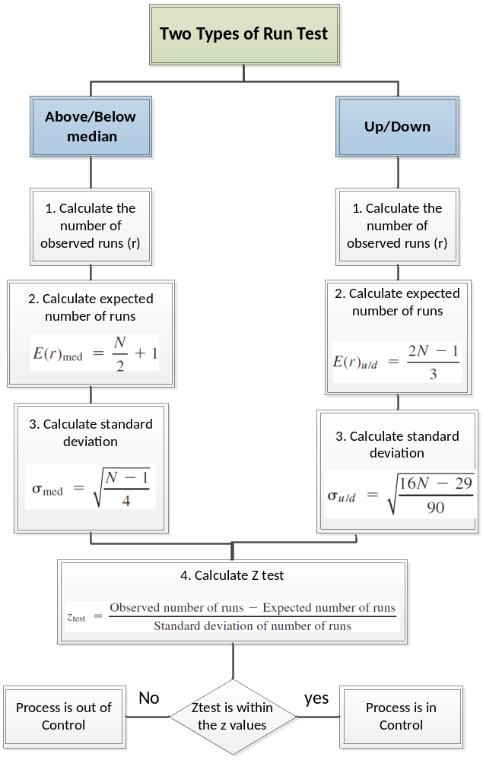

Slide 28
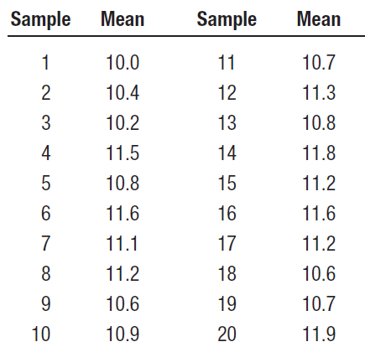
Run Tests Example
Twenty sample means have been taken from a process. The means are shown in the following table. X bar control chart shows that all samples are within the ranges of UCL= 12.5 and LCL = 9.5 hence under control. Use above/below median and up/down run tests with z = 2 to determine if assignable causes of variation are present (note z =2 means the range between -2 and +2 or 95%). Assume the median is 11.0.

Slide 29
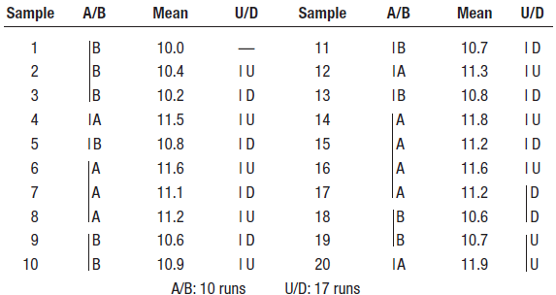
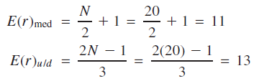
Run Tests Example
Step 1: Calculate the runs using both tests
Step 2: Calculate the expected runs using both tests

Slide 30
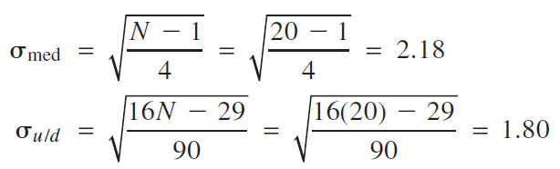
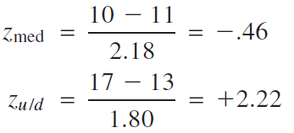
Run Tests Example
Step 3: Calculate the standard deviations for both tests
Step 4: Calculate the Ztest values for both tests

Slide 31
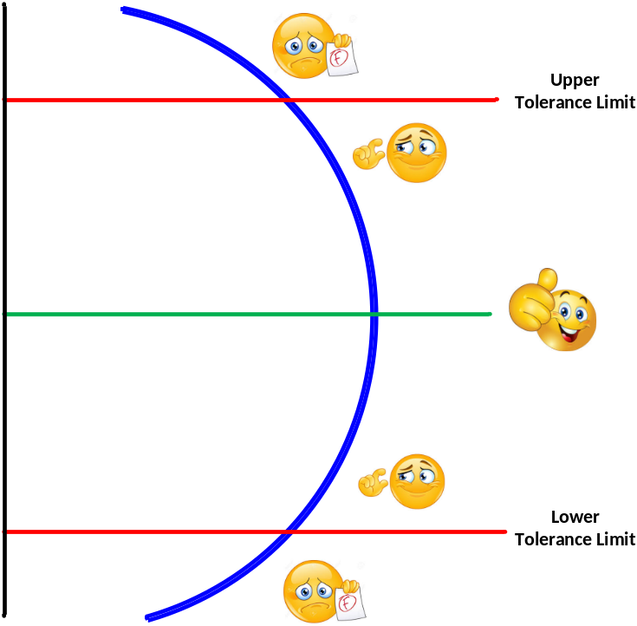
Process Capability
Once a process has been determined to be stable, it is necessary to determine if the process is capable of producing output that is within an acceptable range
  Tolerances or specifications
    Range of acceptable values established by engineering design or customer requirements
  Process variability
    Natural or inherent variability in a process
  Process capability
    The inherent variability of process output (process width) relative to the variation allowed by the design specification (specification width)

Slide 32
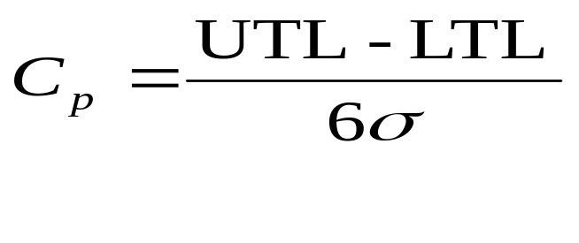
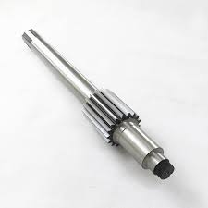
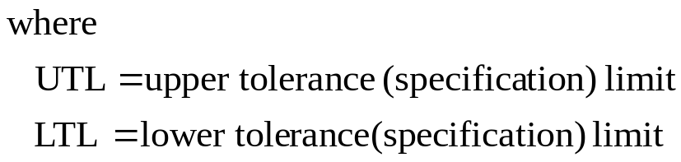
C_{p} Process Capability Ratio
It is the number of times the spread of the process fits into the tolerance width. The higher the value of Cp, the better the process.
For a process to be deemed to be capable, it must have a capability index of at least 1.00.
Cp = 1 ➔ barely capable ➔ 2700 parts per million (ppm)
Cp = 1.33 30 ppm

Slide 33
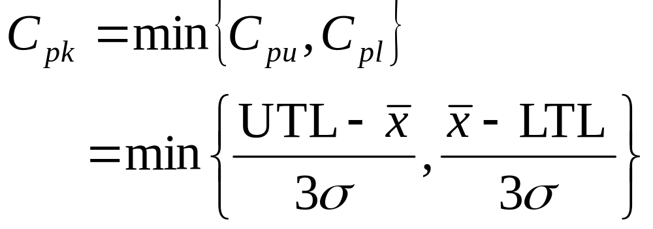
C_{pk} Process Capability Index
Used when a process is not centered at its target, or nominal value
It is the position of the process in relation to the tolerance limits,

Slide 34
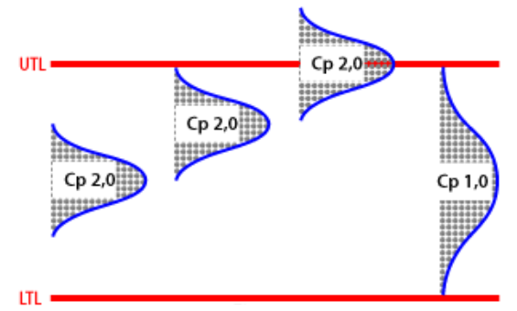
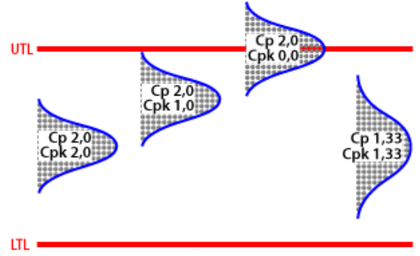
Source: https://www.statisticalprocesscontrol.info/glossary.html#Cp

Slide 35
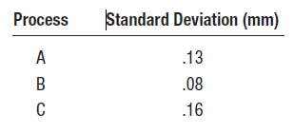
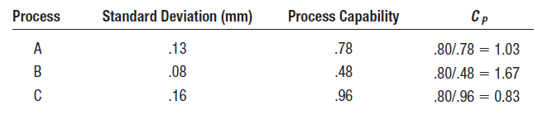
Process Capability Example
A manager has the option of using any one of three machines for a job. The processes and their standard deviations are listed below. Determine which machines are capable if the specifications are 10.00 mm and 10.80 mm.
Solution:

Slide 36
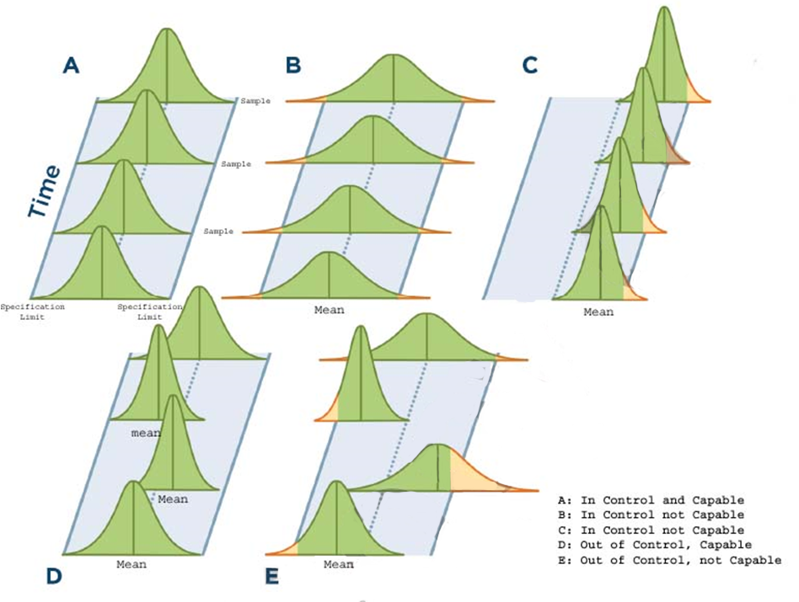

Slide 37
Question

